Slide 1
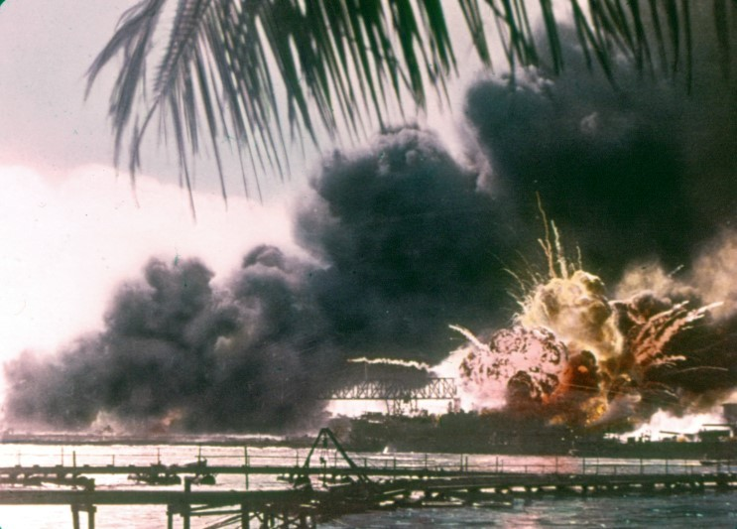

“Air Raid Pearl Harbor. This is not a drill.”
Raymond Rossa, M. A.

Slide 2
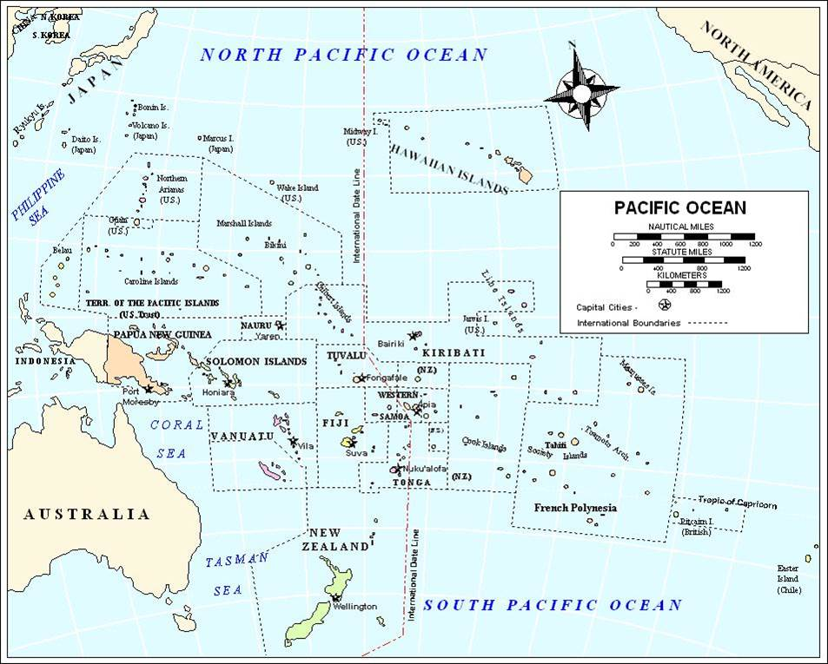

Slide 3
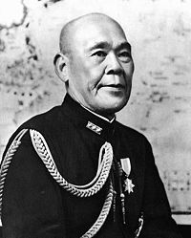
Adm Osami Nagano

Slide 4
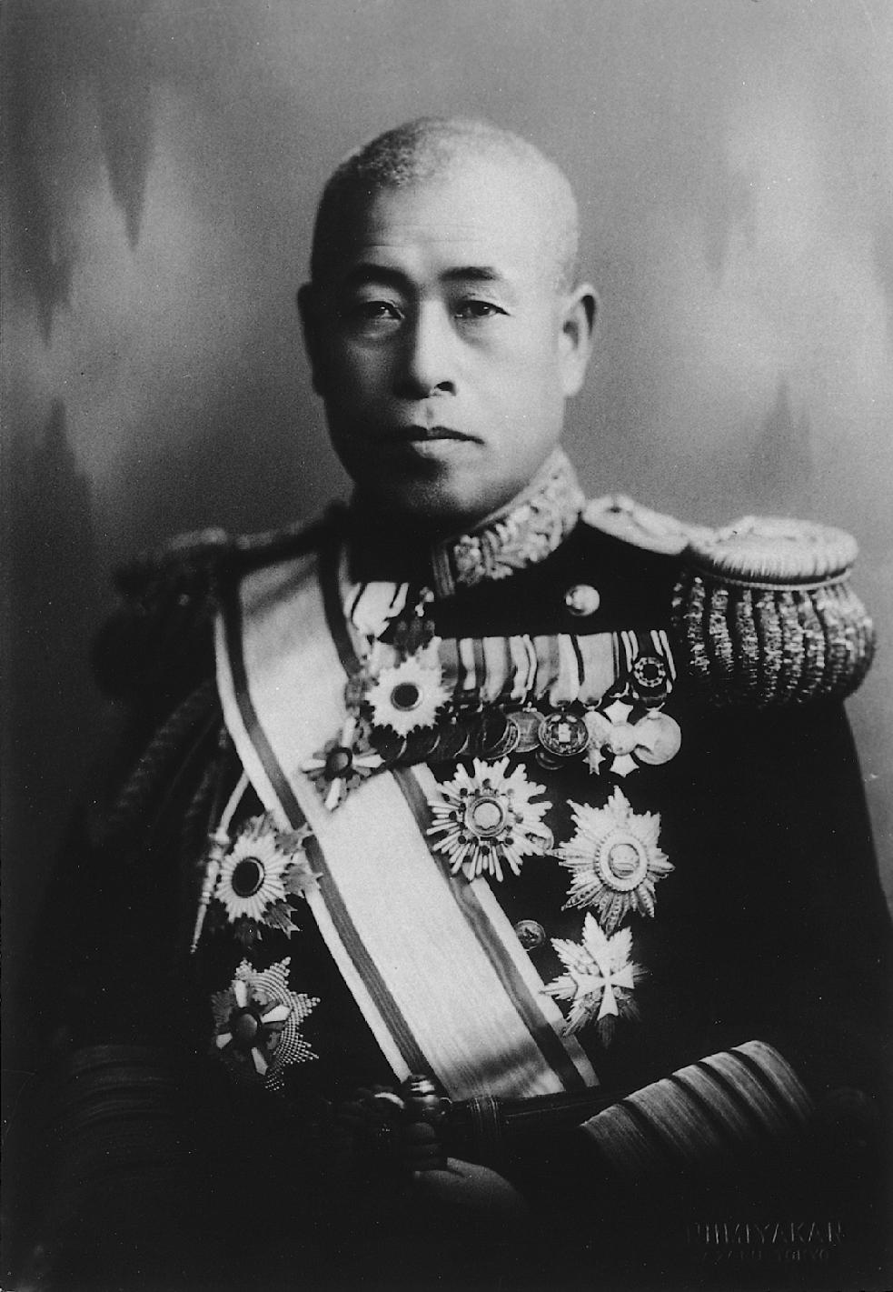
Adm Isoroku Yamamoto

Slide 5
Dai-Ichi Kido Butai
No. 1 Mobile Force
First Striking Force
(1 KB)

Slide 6
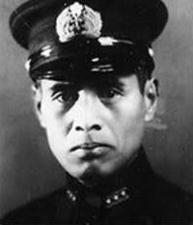
Cdr Minoru Genda

Slide 7
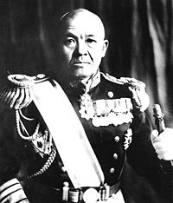
Adm Chuichi Nagumo

Slide 8
Dai-Ichi Kido Butai
All 6 large, fast, fully battle capable, Fleet Aircraft Carriers forged into a single, independent, cohesive tactical attacking unit

Slide 9
Dai-Ichi Kido Butai
Planes of all Aircraft Carriers massed , under the senior commander in the air, into a single swarm to swamp enemy defenses-Required relentless practice/drills to hone habitual coordination to a fine combat edge in air

Slide 10
Dai-Ichi Kido Butai
Master Stroke: Different types of attacking squadrons concentrated (massed combined arms) to overwhelm target by attacking from different directions but all at same time, or nearly same time

Slide 11
Dai-Ichi Kido Butai
CarDiv 1: Akagi Kaga
CarDiv 2: Hiryu Soryu
CarDiv 5: Shokaku Zuikaku

Slide 12
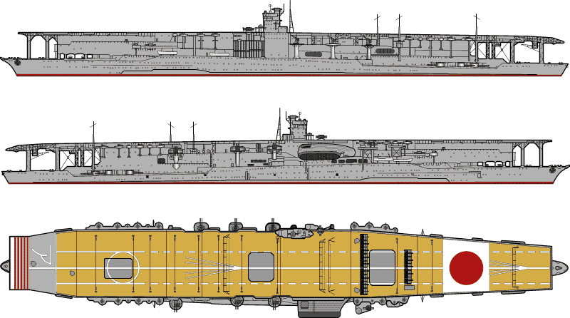
Aircraft Carrier Akagi

Slide 13
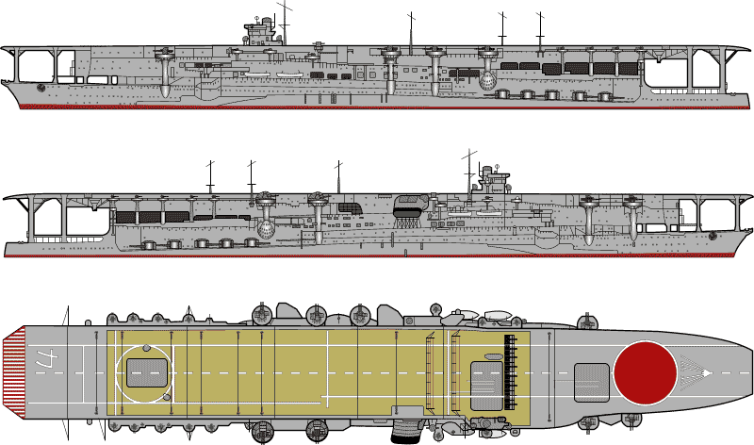
Aircraft Carrier Kaga

Slide 14
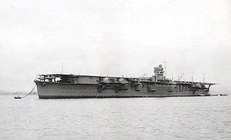
Aircraft Carrier Hiryu

Slide 15
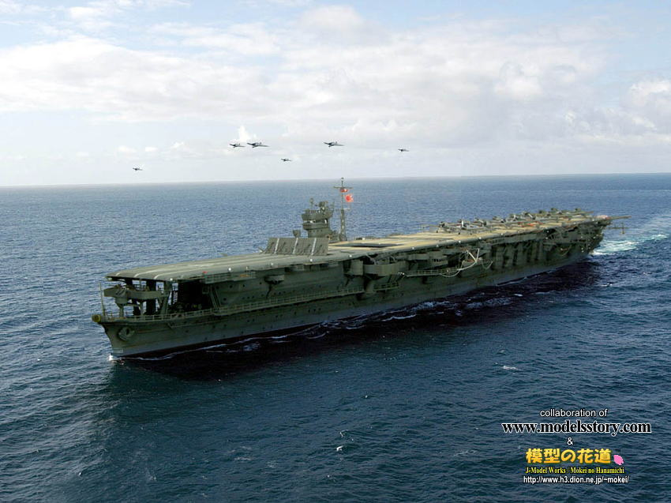
Aircraft Carrier Soryu

Slide 16
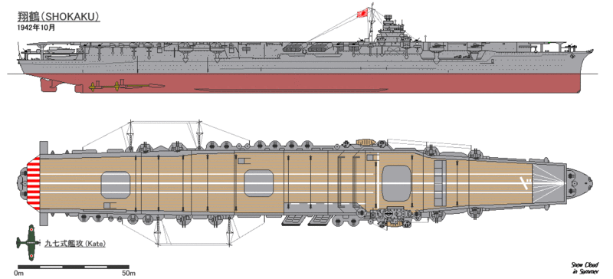
Aircraft Carrier Shokaku

Slide 17
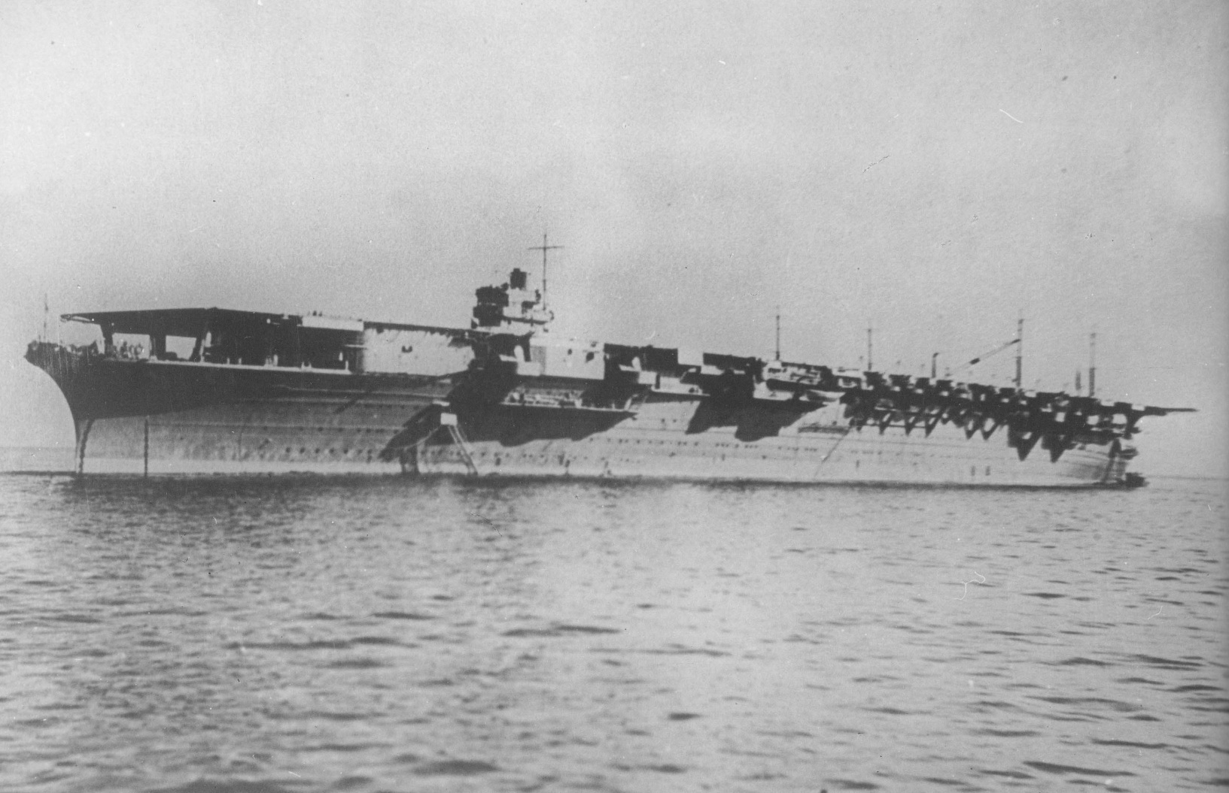
Aircraft Carrier Zuikaku

Slide 18
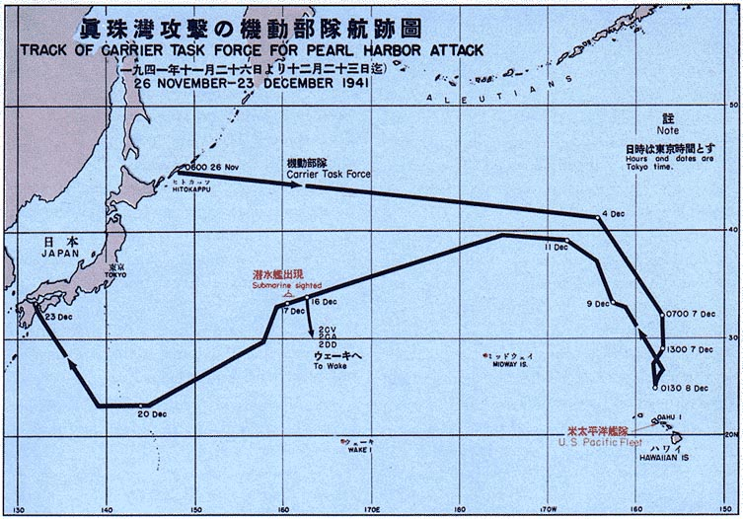
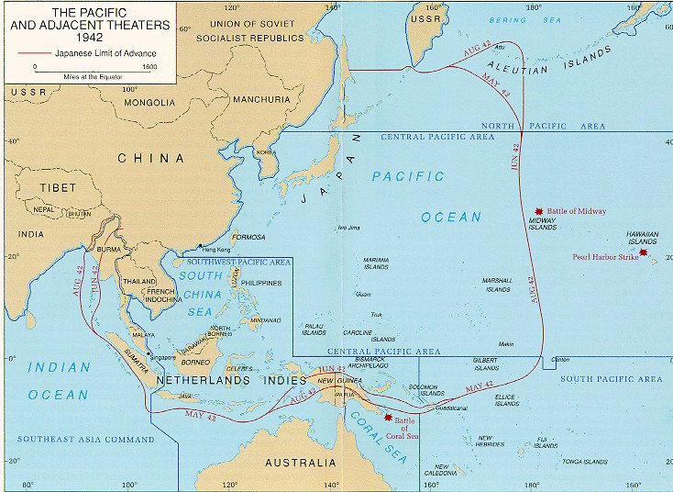
War in the Pacific Ocean

Slide 19
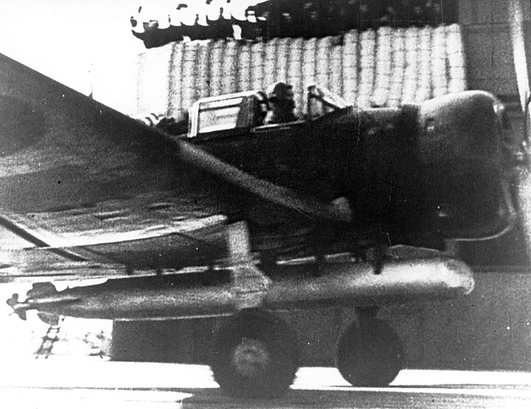
First Wave takeoff - Akagi

Slide 20
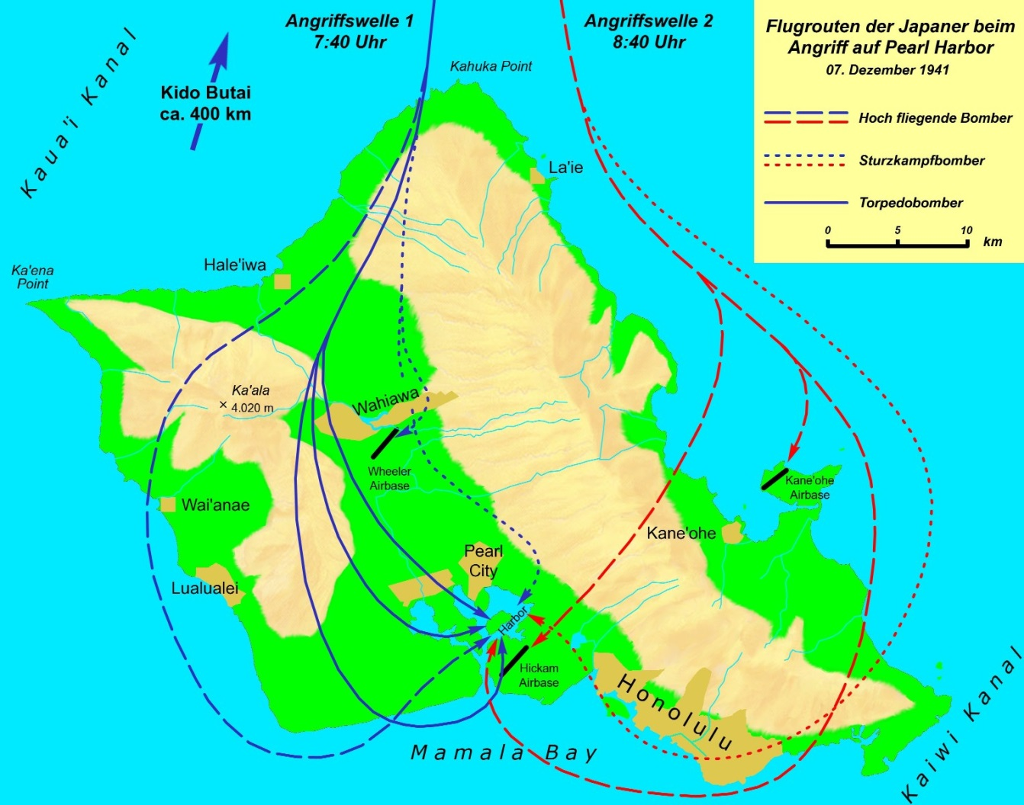

Slide 21
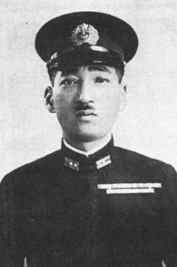
Cdr Mitsuo Fuchida (1st Wave)

Slide 22
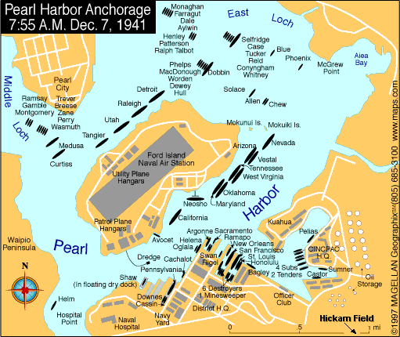

Slide 23
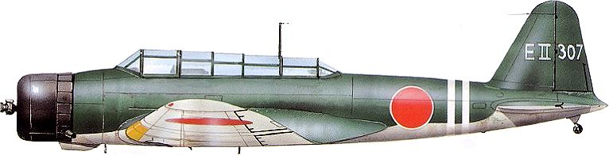
Nakajima B4N (“Kate”) Torpedo Bomber

Slide 24
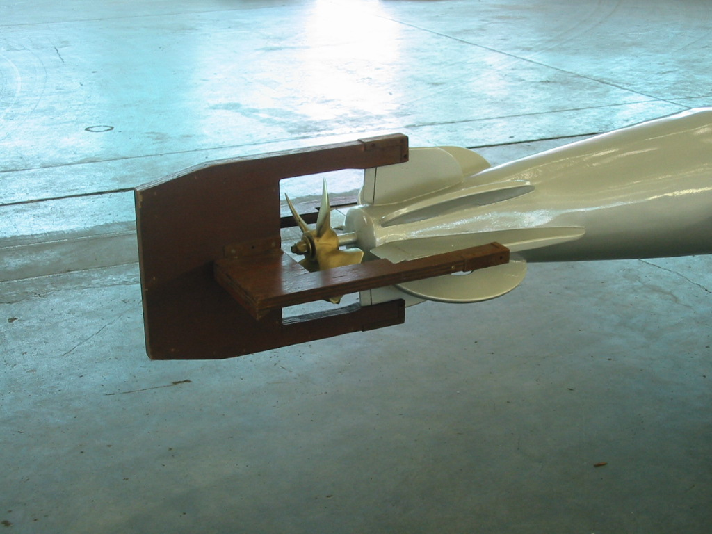
Breakaway Wooden Extension Fins

Slide 25
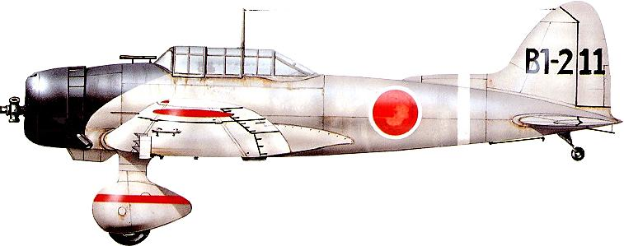
Aichi D3A (“Val”) Dive Bomber

Slide 26
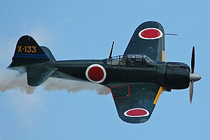
Mitsubishi A6M Type 0 (“Zero”) Fighter

Slide 27
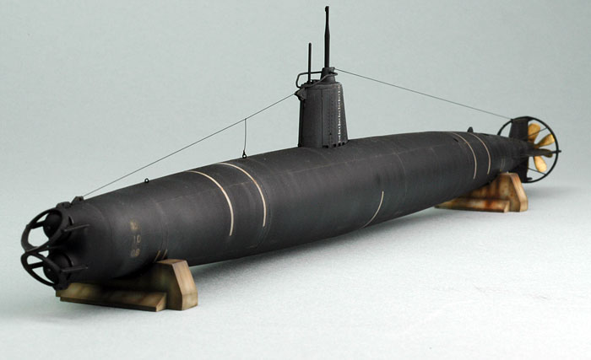
2-Man Midget sub

Slide 28

IJN Battle Flag

