Slide 1
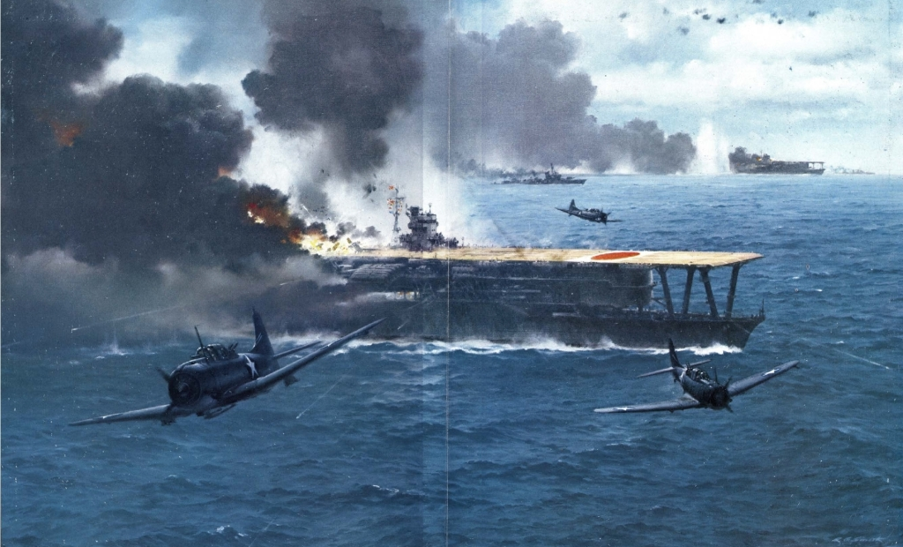

Slide 2
USN v IJN Carrier Air Squadron Combat
Ray Rossa, M. A.

Slide 3
USN v IJN
Institutional/Cultural
Differences

Slide 4
Air Crew
Attrition
Squadron interchangeability
Flexibility

Slide 5
Squadron Types
Fighters (VF)
Dive Bombers (VB)
Scout Bombers (VS)
Torpedo Bombers (VT)

Slide 6
Fighter Combat
Part 1

Slide 7
Fighters (VF)
Mitsubishi A6M, type 00, Mod21 ZERO
Grumman F4F-4 WILDCAT

Slide 8
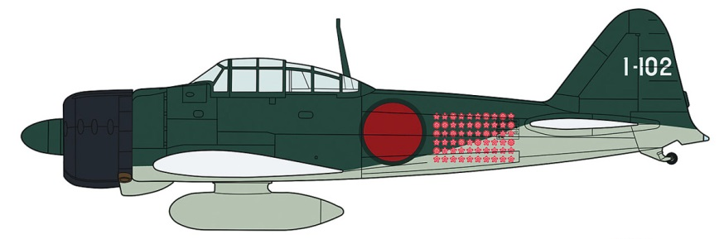
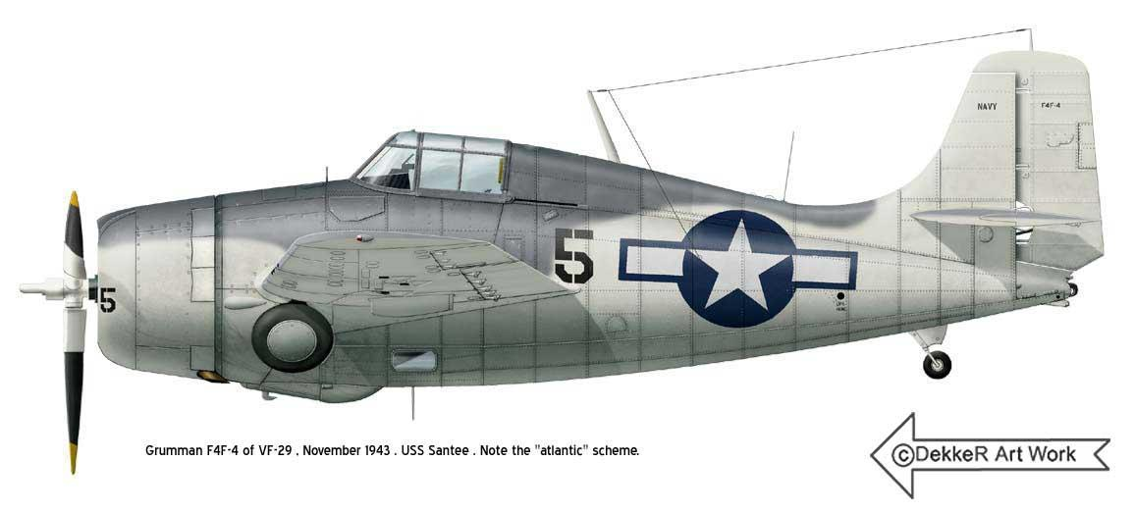

Slide 9
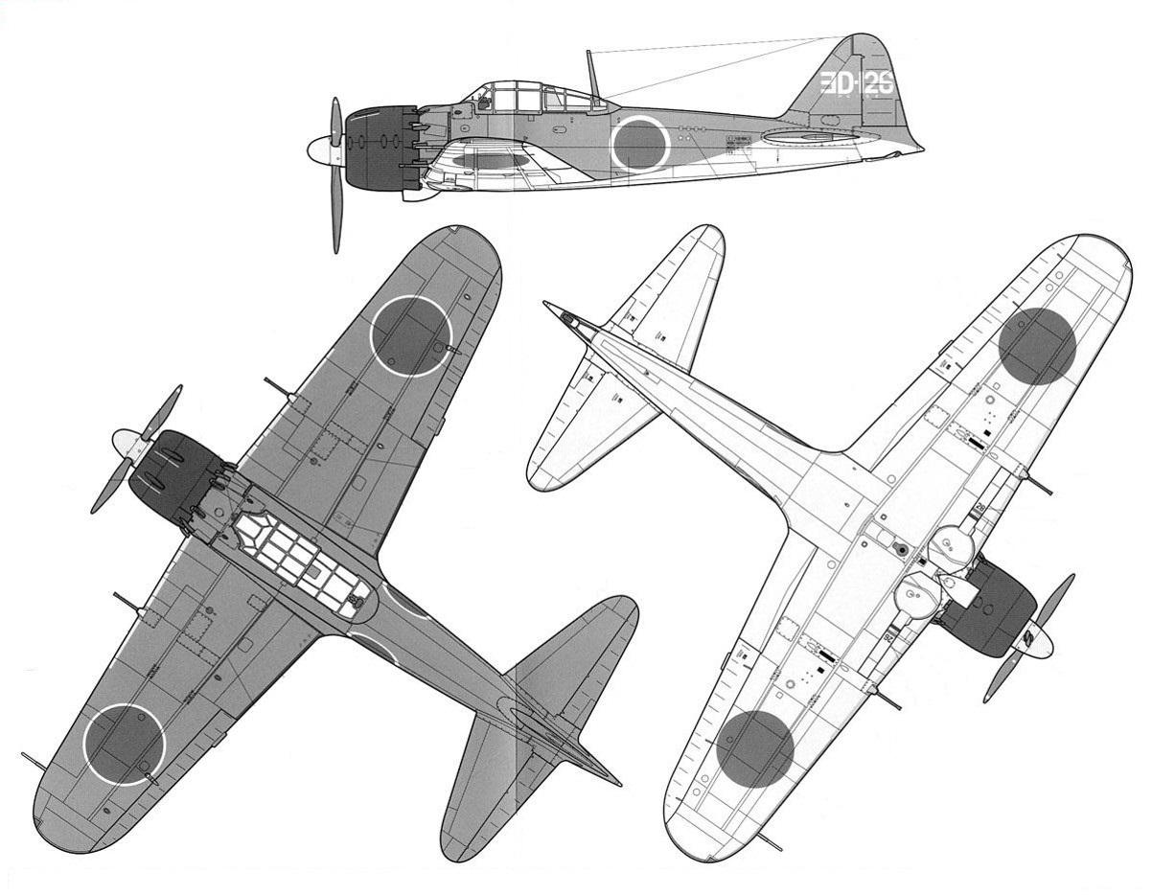

Slide 10
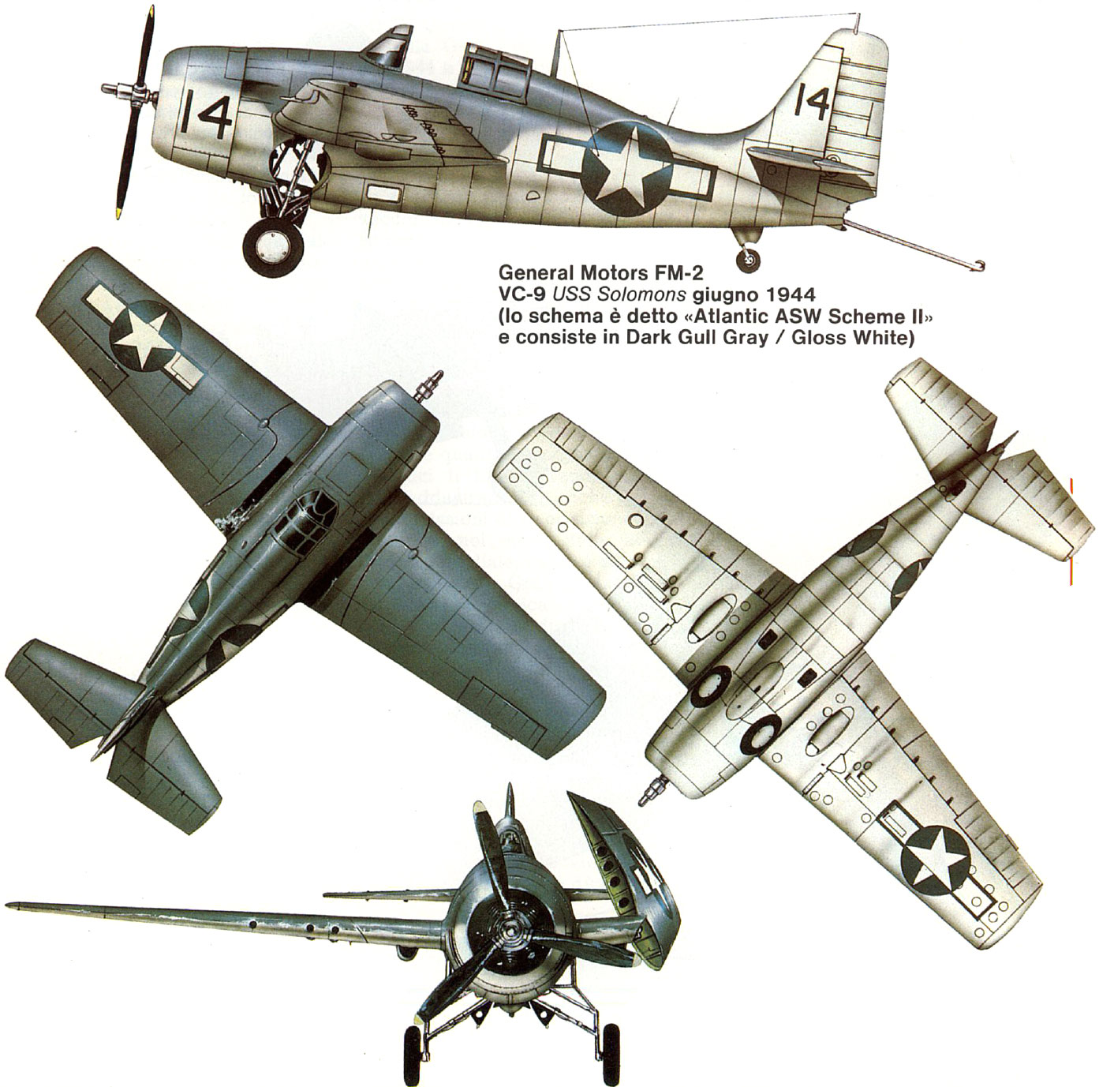

Slide 12
Fighters (VF)
Deflection Shooting

Slide 13
Fighters (VF)
Combat Formations
IJN
USN

Slide 14
Fighters (VF)
Fighter Tactics:
Offensive
Defensive

Slide 15
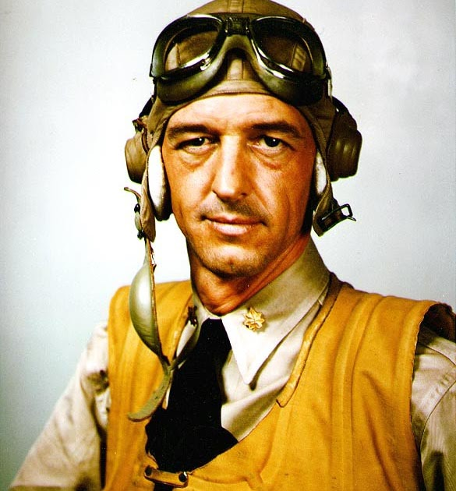
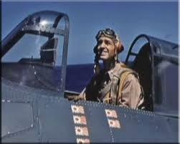
John (Jimmy) Thach

Slide 16
Discussion
Part 1
Q & A

Slide 17
Dive Bomber Torpedo Bomber Combat
Part 2

Slide 18
Dive Bombers (VB)
Aichi D3A1, Type 99, Mod11 VAL
Douglas SBD-3 Dauntless

Slide 19
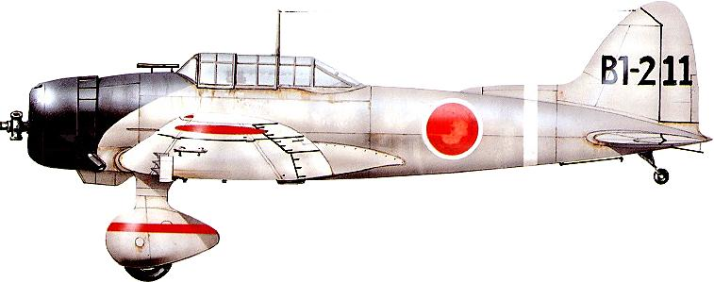
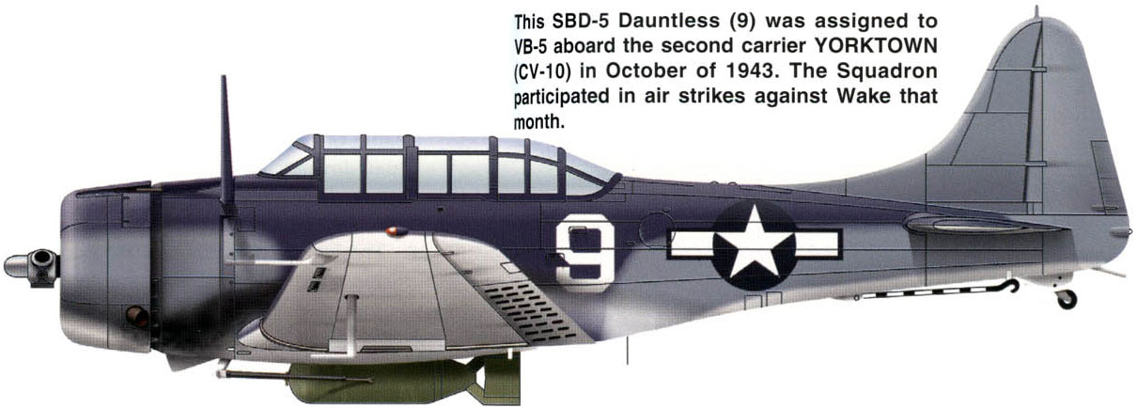

Slide 20
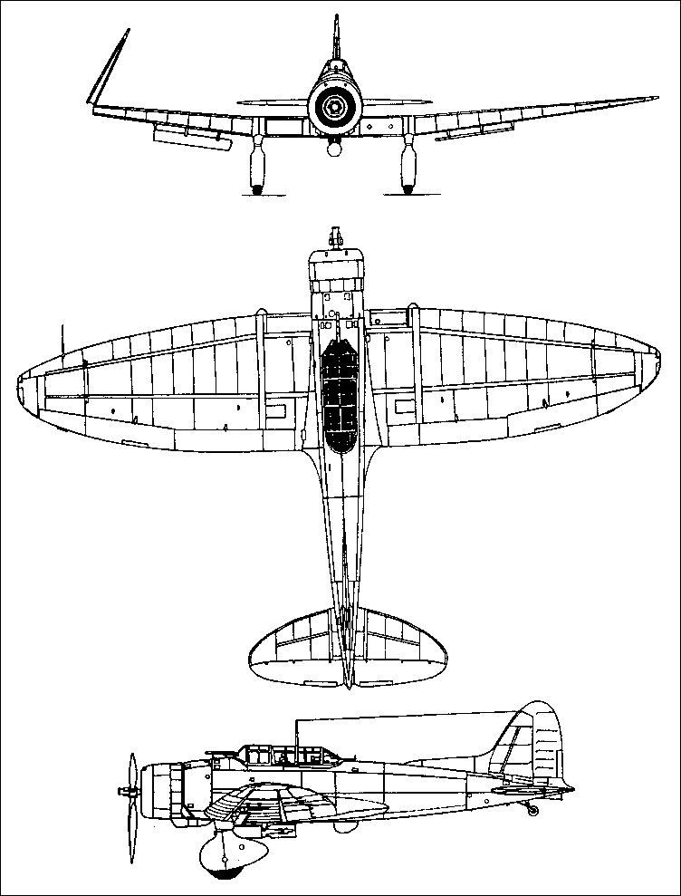

Slide 21
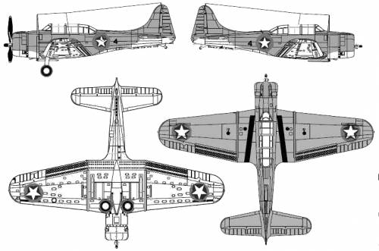

Slide 22
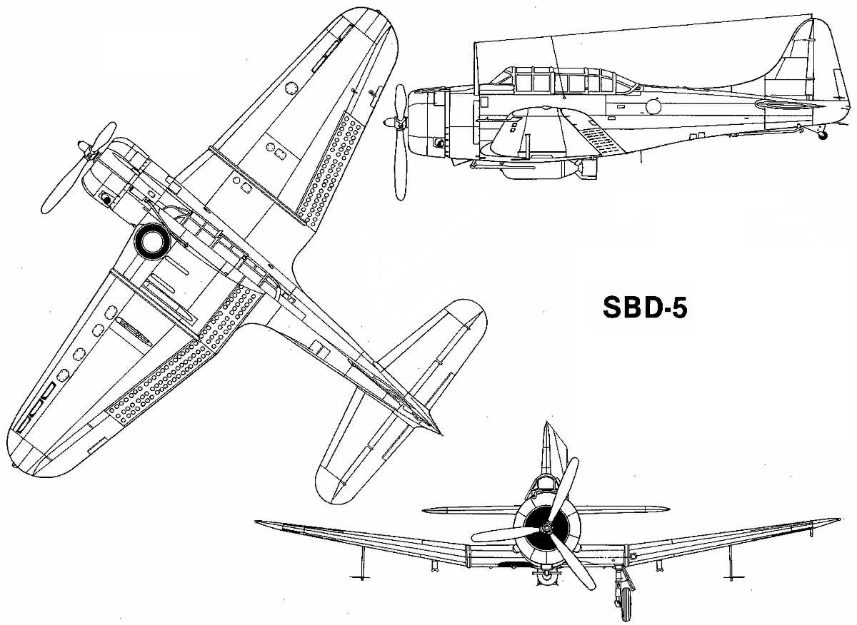

Slide 23
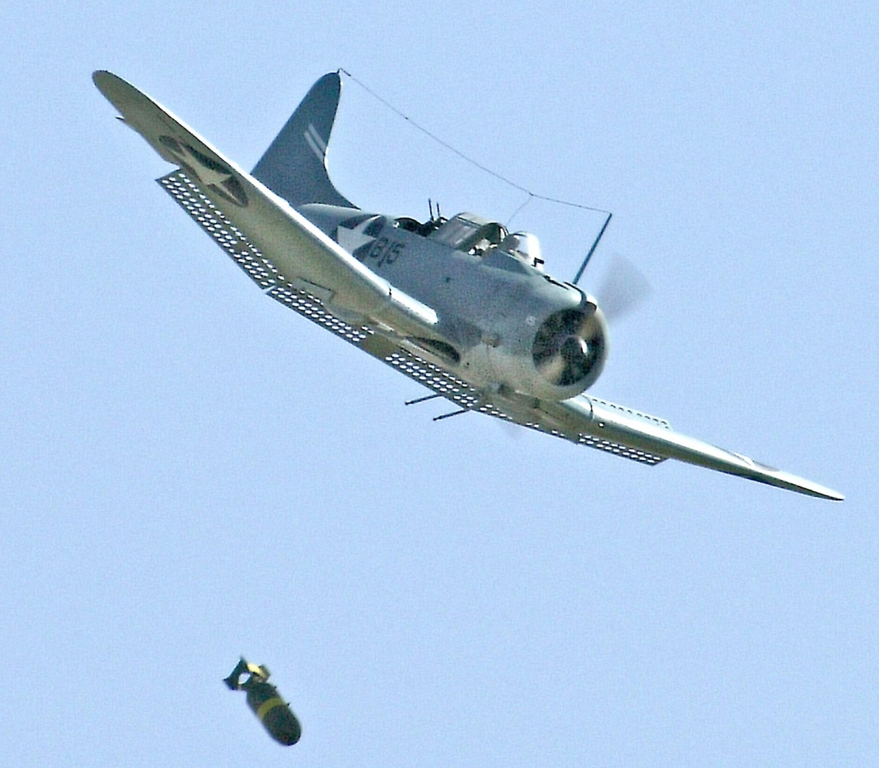

Slide 24
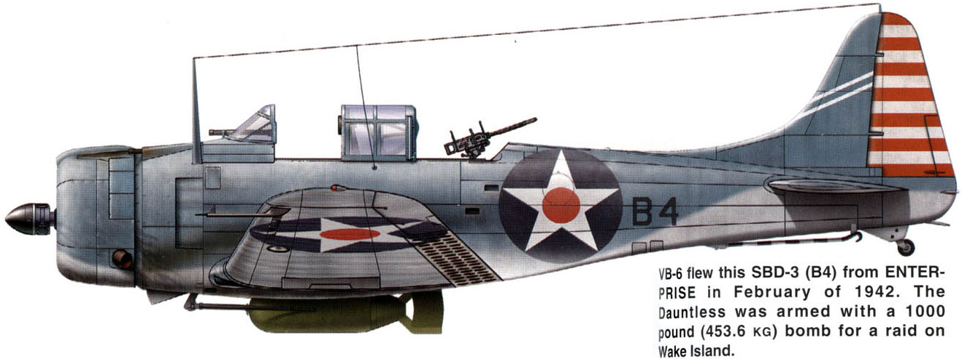

Slide 25
Dive Bombers (VB)
Basic Formations
Cruising
Dive Bombing

Slide 26
Scouts/Recon
Floatplanes/Cruisers
Scout Bombers/Carriers

Slide 27
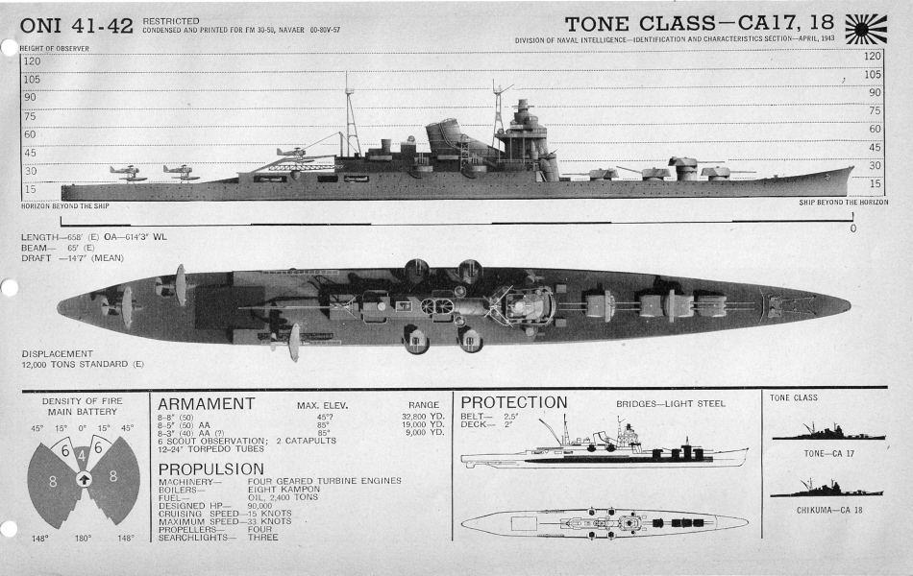

Slide 28
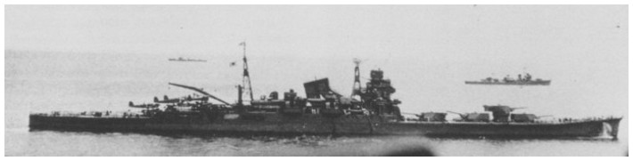

Slide 29
Recon Floatplanes
Aichi E13A, type 0, Jake
Nakajima E8N2, type 95 Dave

Slide 30
Aichi E13A, type 0, Jake
Floatplane

Slide 31
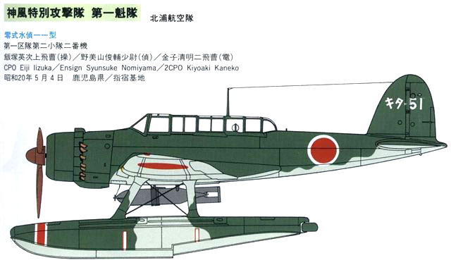

Slide 32
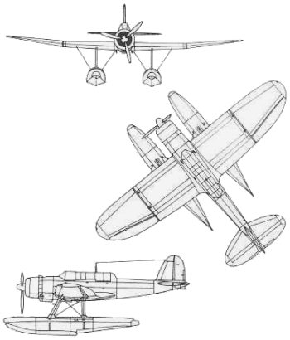

Slide 33
Nakajima E8N2, type 95 Dave
Floatplane

Slide 34
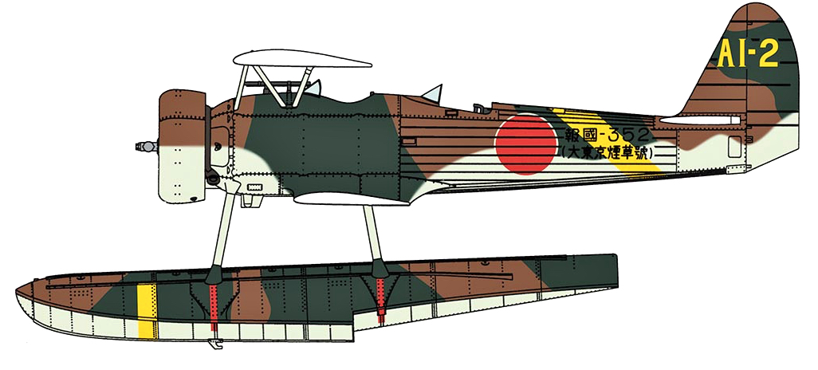

Slide 35
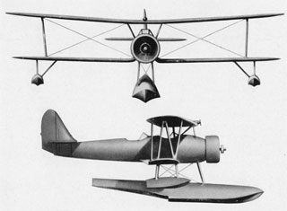

Slide 36
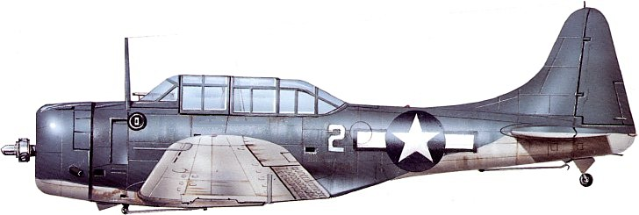
Scout Bombers (VS)

Slide 37
Scout Bombers (VS)
Air Search Doctrine
Cruising
Search/Strike

Slide 38
Scouts/Recon
Critical Importance!
Air Search Challenges
Recon/scouting failure

Slide 39
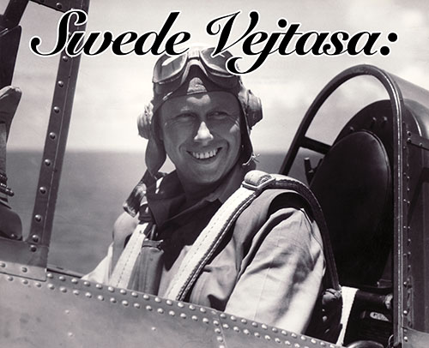
Swede Vejtasa

Slide 40
Torpedo Bombers (VT)
Nakajima B5N2, type 97, Mod11 KATE
Douglas TBD-1 Devastator
Grumman TBF-1 Avenger

Slide 41
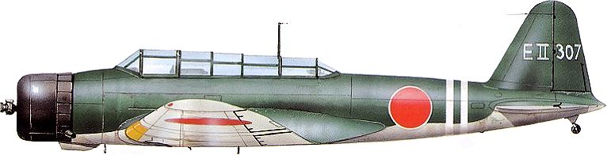
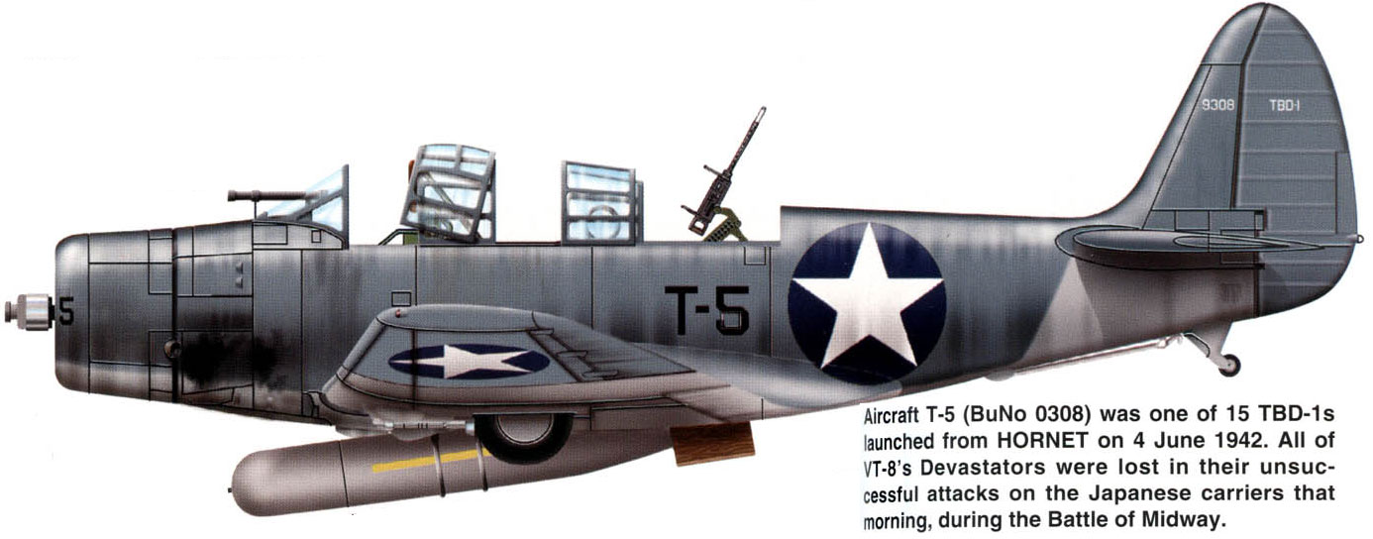

Slide 42
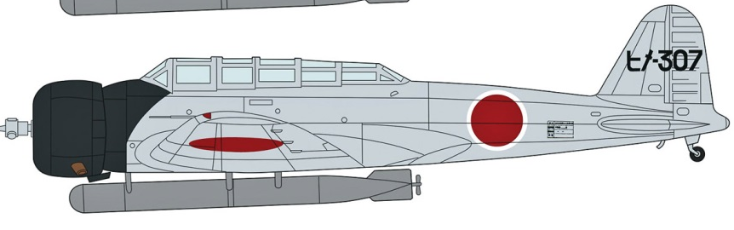
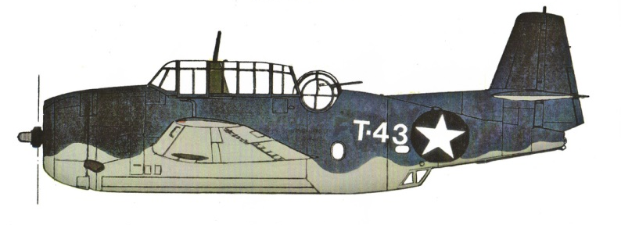

Slide 43
Discussion
Part 2
Q & A

Slide 44
Air Strikes
Part 3

Slide 46
Tactical Comparison
Entire Air Group:
IJN Carriers-Massed
USN Carriers-Single

Slide 47
Attacking Enemy CV
IJN v USN

Slide 48
Defending Own CV
IJN v USN

Slide 49
Conclusion
Tactics/Operations
Q & A

